Slide 1

6th Grade Accelerated Math
Unit 6, Lesson 5 Adding Integers Volume 1, pg. 254

Slide 2


Benchmark
MA.6.NSO.4.1
Apply and extend previous understandings of operations with whole numbers to add and subtract integers with procedural fluency.
volume 1, pg. 254

Slide 3
Integrated Mathematical Thinking and Reasoning Standards
MA.K12.MTR.2.1 Demonstrate understanding by representing problems in multiple ways.
MA.K12.MTR.3.1 Complete tasks with mathematical fluency.
MA.K12.MTR.4.1 Engage in discussions that reflect on the mathematical thinking of self and others.
volume 1, pg. 254

Slide 4

Learning Target
I can add integers with procedural fluency.
volume 1, pg. 254

Slide 5

Warm-Up
volume 1, pg. 255

Slide 6

6.5.1 Warm-Up: True Equations
Using integers between −3 and 3 one time each, fill in the blanks to make the equation true.
volume 1, pg. 255

Slide 7

Exploration
volume 1, pg. 255

Slide 8

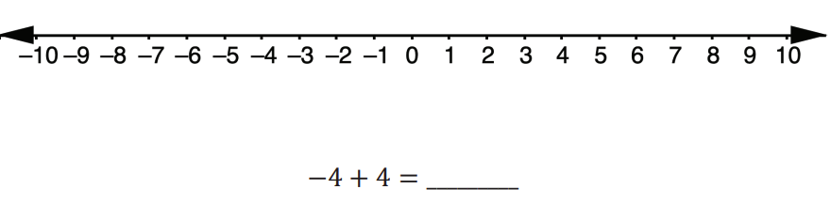
6.5.2 Exploration: Additive Inverses
Use the number line to show the sum of −4 + 4. Then, complete the equation.
2. Represent the sum of −4 + 4 using integer chips.
volume 1, pg. 255

Slide 9
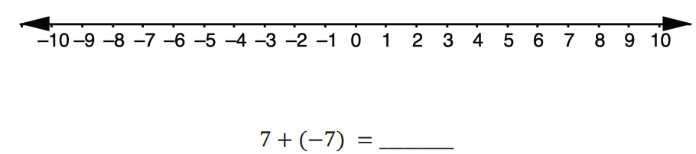
Use the number line to show the sum of 7 + (−7). Then, complete the equation.
Represent the sum of 7 + (−7) using integer chips.
volume 1, pg. 255

Slide 10
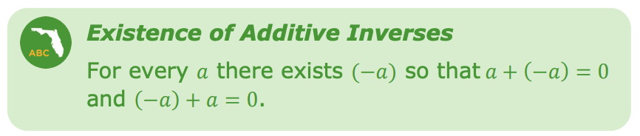
Additive inverses are another way to represent the concept of a zero pair.
5. What number is the additive inverse of −15?
6. What number is the additive inverse of 27?
volume 1, pg. 256

Slide 11
7. Choose any positive integer and write it in the blank: ____.
Use your number to fill in the blanks in the statement.
For the value _______, there exists (−______) so that ______ + (−______) = 0 and (−_______) + ________ = 0
Write your partner’s positive integer: _____.
Use your partner’s number to fill in the blanks in the statement.
For the value _______, there exists (−______) so that ______ + (−______) = 0 and (−_______) + ________=0.
volume 1, pg. 256

Slide 12

Guided Instruction
volume 1, pg. 256

Slide 13
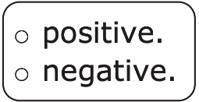
6.5.3 Guided Instruction: Adding Integers
Understanding the existence of additive inverses can be helpful when adding integers with larger absolute values.
Complete each statement based on your understanding of adding integers so far.
a. When adding two positive integers, the sum is
b. When adding two negative integers, the sum is
volume 1, pg. 256

Slide 14
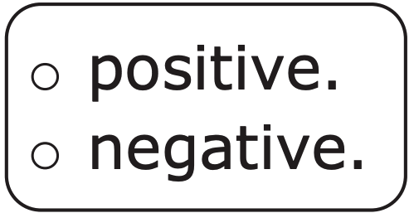
When adding a positive and a negative integer, the sum will be either positive or negative, depending on which value has the larger absolute value.
2. Consider the expression 40 + (−165).
a. What will be the sign of the sum?
b. Explain your reasoning.
volume 1, pg. 256

Slide 15
When adding these integers, zero pairs are created.
Use additive inverses to explain how many zero pairs are created.
What remains after combining the additive inverses?
Complete the equation.
40 + (−165) = ________
volume 1, pg. 257

Slide 16
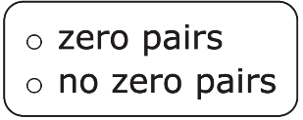

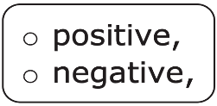
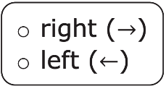
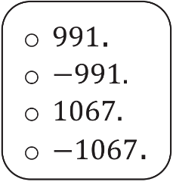
Complete the statements to describe how to find the sum of −1,029 + (−38).
When adding −1,029 + (−38)
are
created because the signs of the addends are
The sum can be found by adding the
absolute values of the addends. Since both addends are
the ray for the second addend of the sum
will go farther to the
of zero on a number line.
The sum of −1,029 + (⁻38) is
volume 1, pg. 257

Slide 17

Collaboration
volume 1, pg. 257

Slide 18

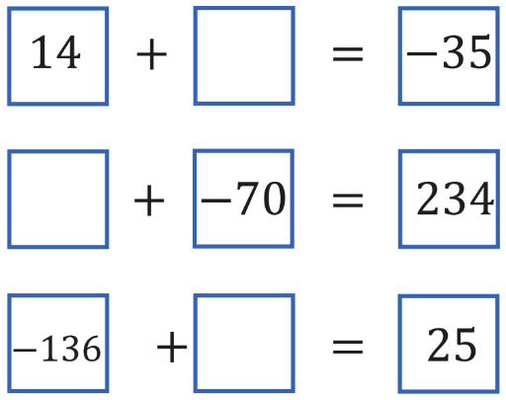
6.5.4 Collaboration: Reasoning With Integers
Work with your partner to fill in the blanks with an integer to make each equation true.
Choose one equation and explain your thinking in determining the missing value.
volume 1, pg. 257

Slide 19

Your Turn
volume 1, pg. 258

Slide 20
6.5.5 Your Turn!
1. Find each sum.
a. 10 + (−204)
c. 904 + (−11)
e. 205 + (−643)
g. −399 + (−405)
i. 703 + (−190)
b. (−99) + (99)
d. −1 + 76
f. −151 + (−70)
h. −80 + 606
j. −600 + (−78)
volume 1, pg. 258

Slide 21

Wrap-Up
volume 1, pg. 258

Slide 22
6.5.6 Wrap-Up: Growth Mindset
1. Today, I am still unsure about ___________________________________________________________________________________.
2. To fill in this gap, I intend to ___________________________________________________________________________________.
volume 1, pg. 258

